Slide 1


Research- and Evaluation-Informed Entrepreneurship Education:
What Do the Data Tell Us?
NCIIA Open Conference
March 22, 2013 –Washington D.C.
Grant Number: 1125457
Notes:
Welcome to this session! [Introduce Shannon, Helen, Angela, Alan, Epicenter, Designing Education Lab]

Slide 2

Session Objectives
Update on current Epicenter research and
evaluation projects
Participate in a hands-on design experience to
connect entrepreneurship research to curricular
choices
Inspire new ideas for entrepreneurship curricula
and module design at your campus
Notes:
This session is designed to share research and evaluation findings, and enliven thinking about ways to apply these findings to entrepreneurship classrooms. We’d really like to get thinking going about ways to make strong connections between what’s happening in the research and evaluation world, and what’s happening in the pedagogical and curricular world.

Slide 3
Session Outline
1. Brief overview of Epicenter research and evaluation
2. Break into “Reading Groups” to review and discuss research findings on entrepreneurship education
3. Move into “Design Groups” to apply findings to
entrepreneurship course and module design
4. “Pitch” your new courses and modules!
Notes:
In this session, we’ll provide a very brief overview of the Epicenter-linked research and evaluation to date;
then we’ll spend about 25 minutes in Reading Groups to review and discuss recent findings from the entrepreneurship literature;
we’ll then spend another 30 minutes in Design Groups;
and close with a 20-minute discussion and “pitch” session.
This is envisioned as a highly collaborative session with a lot of good ground to cover.

Slide 4
Epicenter Mission
The Epicenter is dedicated to unleashing the entrepreneurial potential of undergraduate engineering students across the United States to create bold innovators with the knowledge, skills and attitudes to contribute to economic and societal prosperity.
Notes:
Epicenter, which stands for the National Center for Engineering Pathways to Innovation, began in 2011, is funded by the NSF, and is led by NCIIA and Stanford University. Among its many programs and projects are the Student Ambassadors Program, Lean LaunchPad Faculty Development Workshops, and retreats and conferences for the engineering entrepreneurship community. Epicenter also has a research and evaluation branch, which brings us here.

Slide 5
Epicenter Research and Evaluation Update
Epicenter research projects:
Institutions and programs: What are models of entrepreneurship education for undergraduate engineers?
Students: How do engineering students experience entrepreneurship education?
Graduates: What are the entrepreneurship experiences of engineering alumni?
Courses: How can entrepreneurship content be integrated into engineering courses?
Notes:
So what we have been up to in the past year? The Epicenter research team has been pursuing four major lines of inquiry, organized according to units of analysis: (1) institutions and programs, (2) students, (3) graduates, and (4) courses. It is still quite early in most of these projects, although the next slide shows preliminary findings from inquiry #3: entrepreneurship among engineering alumni. Work related to inquiry #4 will be presented later in this session.

Slide 6
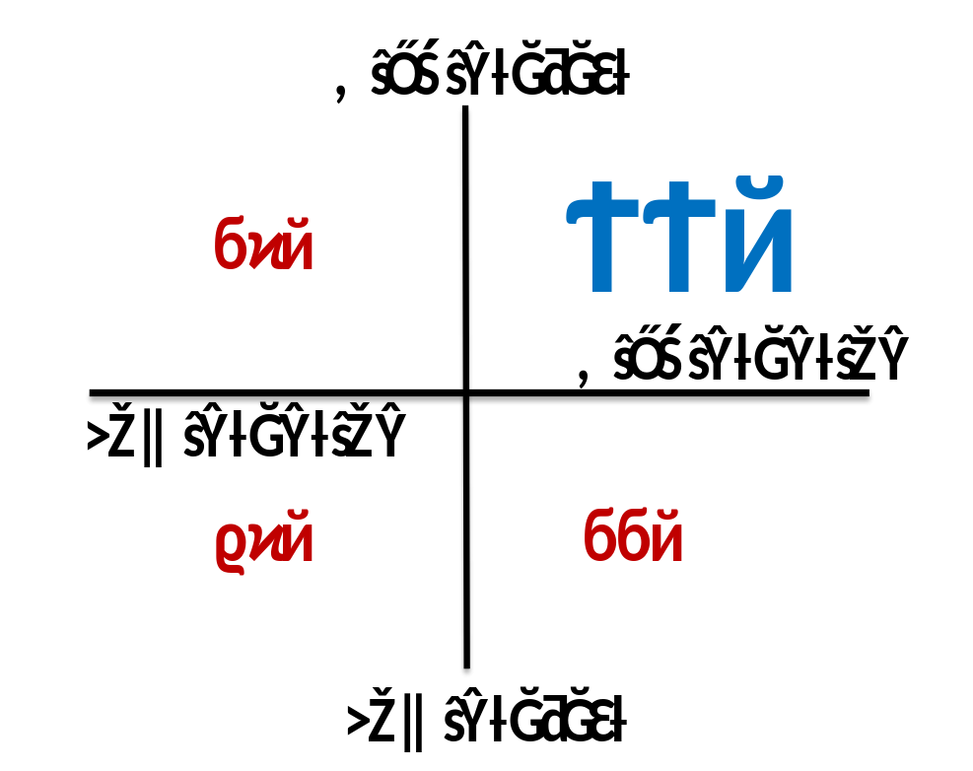
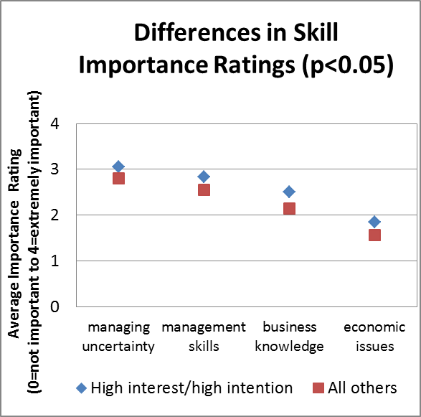
Epicenter Research:
Select Findings
What are the entrepreneurship experiences of engineering alumni?
Notes:
These data draw from the Pathways of Engineering Alumni Research Survey, or PEARS, which was administered to early career alumni from four U.S. engineering schools in 2011. Philipp Mueller and Adam Probst analyzed these data to identify the entrepreneurship experiences and interests of young engineering graduates. Four years post-graduation, 8% of early career engineering alumni had already started their own business.
--When looking at future plans and pathways, 22% had high interest and high intention to be an entrepreneur and start their own companies, respectively, while 54% had low interest and low intention.
--Interestingly, compared to all other early career engineering alumni (represented in red), the high interest-high intention group (represented in blue) assigned significantly higher importance ratings to management and business-related skills in their current work. These skills include “managing uncertainty”, “management skills”, “business knowledge”, and “economic issues”. Of course, additional research is needed to understand the nature of their current work (what are these alumni doing now?), but it is notable that these alumni are in fact drawing from this business/management knowledge base more so than their peers. Which college environments influenced their pathways?
This is just a slice of Epicenter research activity – Epicenter also has a robust evaluation component. I turn this now to Alan Peterfreund, who will share the results of his recent evaluation work.

Slide 7

2012 Evaluation Baseline Survey:
An Overview
Purpose:
To establish a baseline in order to assess changes over time in I&E initiatives
To assist Epicenter team in setting priorities and allocating resources
Respondents:
144 Engineering faculty members and administrators from 90+ institutions
Three cohorts: ASEE Campus Reps, Epicenter Retreat participants, ASEE Newsletter subscribers
Notes:
During the fall of 2012, we developed and administered a survey focused on innovation and entrepreneurship (I&E) in undergraduate engineering education.
The purpose of this study was (a) to establish a baseline that could be used by Epicenter to assess change over time in I&E initiatives within this community, and (b) to provide information to the Epicenter team that would assist in setting priorities and allocating resources.
Based on the responses of 144 faculty and administrators, representing more than 90 higher education institutions, there is strong evidence of an emerging engagement of I&E among engineering programs.

Slide 8
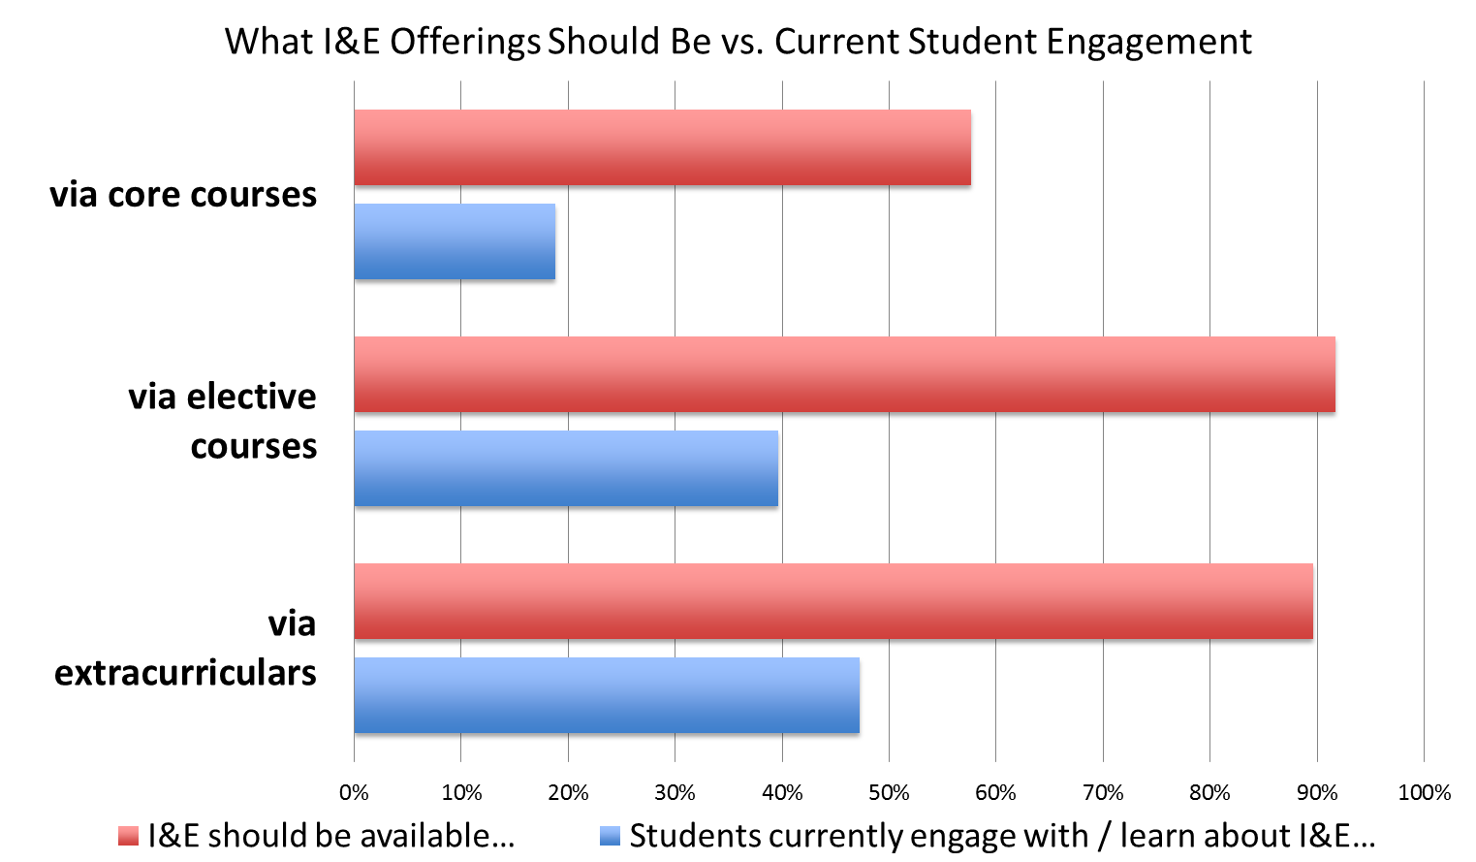
Student Engagement
Notes:
-­ Most schools offer extracurricular activities and many have elective courses focused on I&E.
-­ Only a few have I&E as part of the core curriculum.
-­ There is almost universal interest in increasing the presence of extracurricular and elective course offerings and a majority view that I&E should be part of the core curriculum.

Slide 9
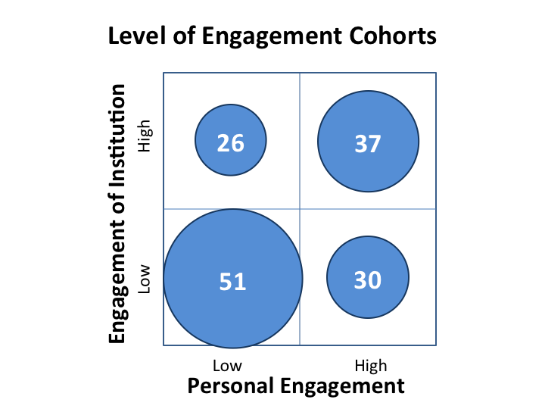
Engagement:
Faculty & Schools
N = 144
Notes:
On most campuses, the number of faculty engaged in supporting I&E education is said to be limited.

Slide 10
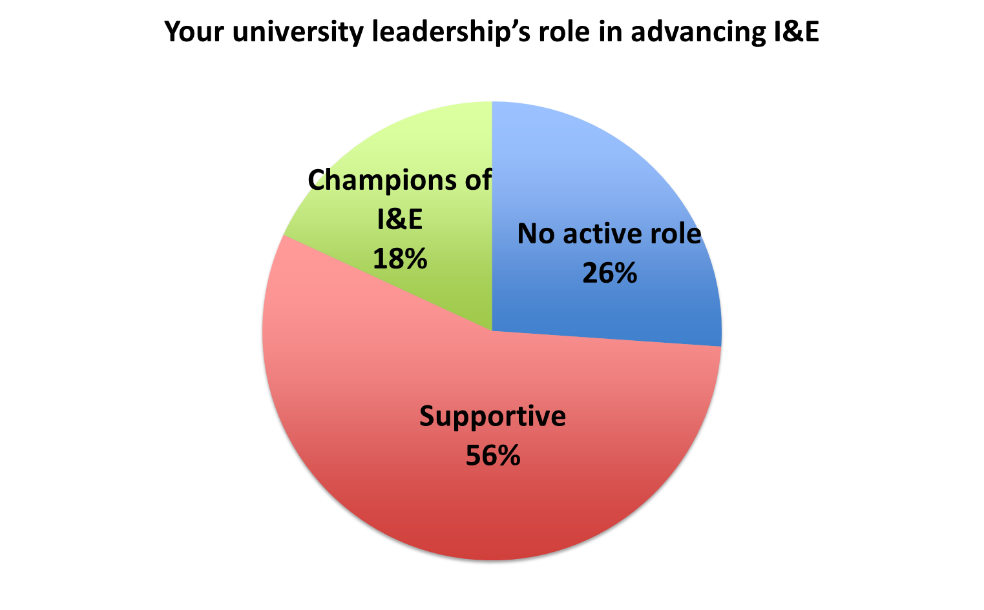
Leadership Support
Notes:
Most see their university leadership as supportive of I&E: engaged in early or more advanced stages of strategic planning. A handful describe their university leaders as champions of using I&E initiatives to fundamentally change engineering education.

Slide 11
Challenges
Common challenges (from open-ended responses):
  Finding space in the engineering curriculum
  Overcoming faculty (and admin) resistance
  Identifying funds
  Building expertise
Notes:
Common challenges emerging include finding space in the engineering curriculum, overcoming faculty (and to a lesser degree, administrative) resistance, identifying funds, and building expertise.

Slide 12
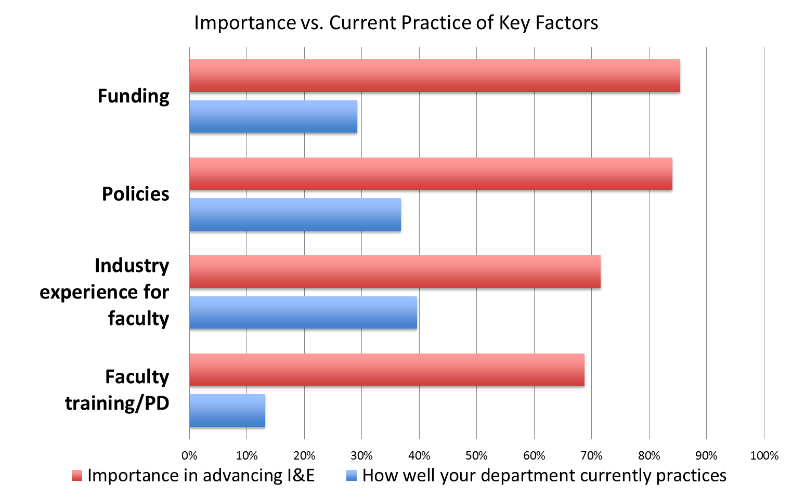
Current and Desired Gap
Notes:
Respondents see a large gap between current and desired practices that could advance I&E initiatives

Slide 13
Needs Assessment
Institutions
Faculty & Curricula
Assistance in developing I&E-friendly policies
Examples of and information about successful models
Assistance identifying possible funding sources
Access to modular content, especially for existing courses
Professional development
Tools for assessing student learning
Participation in a community of practice / social movement
Notes:
At the institutional level, respondents want assistance in developing policies that encourage I&E education, discovering information about successful models, and identifying possible funding sources.
In support of faculty and curriculum, respondents see a need for access to content that can be embedded in existing courses, professional development in relevant pedagogies, tools for assessing student learning, and (for those already engaged) participation in a community of fellow practitioners and thinkers.

Slide 14
Session Outline
1. Brief overview of Epicenter research and evaluation
✓
2. Break into “Reading Groups” to review and discuss research findings on entrepreneurship education
3. Move into “Design Groups” to apply findings to
entrepreneurship course and module design
4. “Pitch” your new courses and modules!
Notes:
Thank you, Alan!
Where are we now in this session? It is now time to move into the more interactive portion of the session, where we start connecting research to course design. We will break into Reading Groups, where we will be reading mini-articles – excerpts from actual articles on entrepreneurship education. We’ll discuss the findings of these articles in our groups. Then move into the design task – applying findings to course design.
Before we introduce the readings, however, who here has already been drawing from specific research in their course design and decision-making? (show of hands) What have been the articles you’ve been drawing from? **NOTE: IN THE SESSION, NO ONE RAISED THEIR HANDS TO INDICATE THAT THEY WERE DRAWING FROM RESEARCH TO INFORM COURSE DESIGN.
This session will hopefully build these connections and give everyone a taste of this process.

Slide 15
Mini-Article Review
Reading Group 1 (Circles): A synopsis of:
Lucas et al. (2009). Industry placement, authentic experience and the development of venturing and technology self-efficacy. Technovation, 29, 738-752.
Reading Group 2 (Squares): A synopsis of:
Neck and Greene. (2011). Entrepreneurship education: Known worlds and new frontiers. Journal of Small Business Management, 49, 55-70.
Reading Group 3 (Triangles): Excerpts from:
Schar et al. (2013). Bending moments to business models: Integrating an entrepreneurship case study as part of core mechanical engineering curriculum. Paper accepted for presentation at the annual meeting of the American Society for Engineering Education, Atlanta, GA.
Notes:
Our first activity is to break into three reading groups:
You have a Circle, Square, of Triangle at the top of the hand-out in front of you.
Circles, you will be in Reading Group 1, and you are assigned to read Lucas…[give description of Lucas’s work]
Squares, you will be in Reading Group 2, and you will be reading Neck…[give description of Neck’s work]
Triangles, you will be in Reading Group 3, and you will be reading Schar…[note how Schar’s article is part of Epicenter’s fourth line of research inquiry mentioned earlier]
At the very end of the session tonight, you will be welcome to grab mini-articles that you did not read in your Reading Group to take with you, as well as the worksheet that accompanies Schar’s case study.
But for now, you will have 10 minutes to read your mini-article in your reading group, and then 10 minutes for discussion within your reading group….

Slide 16
Mini-Article Review
Questions to discuss in your Reading Group:
What are the main takeaways of these findings for entrepreneurship course and module design?
How do these findings resonate with your own insights and experiences in teaching and researching entrepreneurship education?
What new questions and ideas emerge for you as you read this research?
Notes:
These are the questions for discussion in your reading groups: 1, 2, and 3.
One of us will be sitting in on each reading group to facilitate discussion. **NOTE: IN THE SESSION, SHANNON SAT IN ON READING GROUP 1, ANGELA SAT IN ON READING GROUP 2, AND HELEN SAT IN ON READING GROUP 3.
Okay, let’s break into our Groups and start reading! **NOTE: IN THE SESSION, WE HAD ALREADY ARRANGED THE ROOM INTO CLUSTERS OF CHAIRS SUCH THAT WE WERE ABLE TO EASILY DISTRIBUTE LUCAS TO “READING GROUP 1” (CLUSTERED AT THE LEFT OF THE ROOM), NECK TO “READING GROUP 2” (CLUSTERED AT THE CENTER OF THE ROOM), AND SCHAR TO “READING GROUP 3” (CLUSTERED AT THE RIGHT OF THE ROOM).
(10 minute buzzers, for reading and then for discussing….)

Slide 17
Session Outline
1. Brief overview of Epicenter research and evaluation
✓
2. Break into “Reading Groups” to review and discuss research findings on entrepreneurship education
✓
3. Move into “Design Groups” to apply findings to
entrepreneurship course and module design
4. “Pitch” your new courses and modules!
Notes:
It is now time to move into our design groups, and apply the findings from our research to a design task. We’ll spend about 30 minutes on this design activity in total – leaving time for a pitch session at the end.

Slide 18
Design Tasks
Setting the stage:
You’ve been asked to be part of a faculty design group to design an ENTREPRENEURSHIP-RELATED COURSE OR MODULE that will engage engineering students.
Notes:
Before we break into those Design Groups, what is this design task? To set the stage, imagine you’ve been asked to be part of a faculty team to design an ENTREPRENEURSHIP-RELATED COURSE OR MODULE that will engage engineering students.

Slide 19
Design Tasks
Your design group will work on one of the following three tasks:
Design Task Senior: Design a senior capstone design course that has the explicit objective of teaching 1-2 entrepreneurship skills. This capstone course includes both engineering and business students.
Design Task Tech: Develop a module for a core technical course in the engineering curriculum. The module is designed to teach students how to situate engineering concepts in an entrepreneurial frame.
Design Task First-Year: Develop an introductory engineering course for first-year students that tasks them with developing a new technology concept for underserved communities. Students will learn about entrepreneurship as part of the segment on “bringing your technology to market”.
Notes:
Your design group will be assigned to one of the following three tasks: Design Task Senior, Design Task Tech, or Design Task First-Year.
Each Design Group will be comprised of a mix of people who have read Lucas, Neck, or Schar. And your “job”, as a faculty design group, is to address the following questions….

Slide 20
Design Tasks
Questions to address:
Which type of faculty member(s) will teach this course/module?
What are the core entrepreneurial skills you would focus on?
How is the course/module reflecting Neck and Greene’s idea of “entrepreneurship as method”?
How is it addressing Lucas et al.’s “authenticity of experience”?
Drawing from Schar et al., how is it integrating entrepreneurship knowledge and engineering knowledge? (If you are going to employ a case, what will the case narrate and show?)
How would you pitch this course in 2-3 minutes to prospective students?
Notes:
These are the questions to address.
No need to memorize these now - we’ll pass out a sheet for you to jot down your notes, and plan to collect these sheets from you, one per group.
Let’s now move into design groups. Note at the top of your paper you also have a color. All of the REDs, please raise your hand. Why don’t we have the REDs move over here. (If you have ORANGE, YELLOW, GREEN, BLUE, PURPLE…..)
**NOTE: WE HAD ALREADY COLOR-CODED EACH MINI-ARTICLE WITHIN EACH READING GROUP, SUCH THAT THERE WOULD BE A ROUGHLY EVEN MIX OF REDS ACROSS THE THREE READING GROUPS, A ROUGHLY EVEN MIX OF ORANGES ACROSS THE THREE READING GROUPS, AND SO ON.

Slide 21
Design Tasks
Your design group will work on one of the following three tasks:
Design Task Senior: Design a senior capstone design course that has the explicit objective of teaching 1-2 entrepreneurship skills. This capstone course includes both engineering and business students.
Design Task Tech: Develop a module for a core technical course in the engineering curriculum. The module is designed to teach students how to situate engineering concepts in an entrepreneurial frame.
Design Task First-Year: Develop an introductory engineering course for first-year students that tasks them with developing a new technology concept for underserved communities. Students will learn about entrepreneurship as part of the segment on “bringing your technology to market”.
Notes:
RED and ORANGE groups: each of your groups is assigned to the Design Task Senior. Each of your teams will be working on this capstone course.
YELLOW and GREEN groups: each of your groups is assigned to the Design Task Tech. Each of your teams will be working on this module for a core technical course in the engineering curriculum
BLUE and PURPLE groups: each of your groups is assigned to the Design Task First-Year. Each of your teams will be working on this course for first-years.
Questions?
**NOTE: IN THE SESSION, WE DID NOT HAVE ENOUGH PEOPLE TO FORM A PURPLE GROUP, SO THERE WAS ONLY ONE GROUP WORKING ON DESIGN TASK FIRST-YEAR.

Slide 22
Session Outline
1. Brief overview of Epicenter research and evaluation
✓
2. Break into “Reading Groups” to review and discuss research findings on entrepreneurship education
✓
3. Move into “Design Groups” to apply findings to
entrepreneurship course and module design
✓
4. “Pitch” your new courses and modules!

Slide 23
Design Groups
“Pitch your course” in 2-3 minutes:
How would you “market” this course to eligible students? What’s the draw (especially for engineering students)?
Notes:
[Before starting the pitch session, ask “what was surprising about this exercise?” “What new ideas did you take away?”)]. **NOTE: IN THE SESSION, RESPONDENTS REMARKED THAT THIS WAS A GOOD WAY TO GET THEM THINKING ABOUT RESEARCH. THEY APPRECIATED HAVING THREE ARTICLES TO DRAW FROM IN ADDRESSING PROBLEMS (“MULTIPLE PERSPECTIVES”).
(Have Angela or Alan stand in as an engineering student who might be interested in taking a course. How will the course be pitched to them?)
**NOTE: IN THE SESSION, WE ACTUALLY HAD ABOUT 10 MINUTES FOR THIS COMPONENT. EACH DESIGN TEAM BASICALLY SUMMARIZED THE COURSE THEY HAD CREATED; THEIR NOTES ARE INCLUDED IN THE “DESIGN TASK HAND-OUT SUMMARY”.

Slide 24
Session Objectives
Update on current Epicenter research and
evaluation projects
Participate in a hands-on design experience to
connect entrepreneurship research to curricular
choices
Inspire new ideas for entrepreneurship curricula
and module design at your campus
Notes:
(Re-cap of objectives)

Slide 25
Thank you!
Please complete our session evaluation form AND sign up for more information about upcoming Epicenter research and evaluation events!
Notes:
[We’ll have session eval forms with custom questions as well as a contact sheet]

